Slide 1
HealthChain: Charity Web app using blockchain
Presented by: Meric Sapkota, Sujan Thapa Magar, Utsav Satyal, Sapun Meher Shrestha

Slide 2
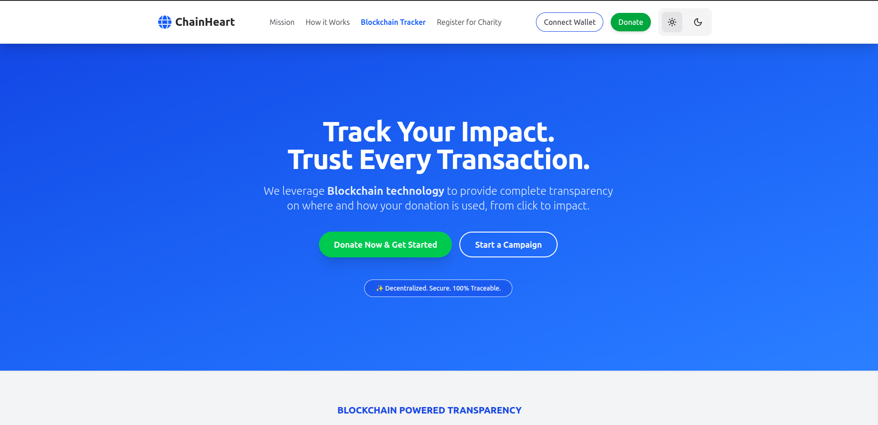
OVERVIEW
Introduction & Problem Statement
HealthChain is a blockchain-based charity platform for healthcare support in Nepal. It connects donors, patients, hospitals, and NGOs in a transparent ecosystem. All donations are recorded on blockchain for trust and accountability.
lack transparency.
Risk of fund misuse
Traditional charity systems are centralized and lack transparency.
Risk of fund misuse, data manipulation, and fraud.

Slide 3
OUR GOALS
Existing System vs Proposed System
Existing
Centralized, low transparency, limited traceability.
Manual verification and reporting.
Higher risk of fraud.
Proposed
Decentralized blockchain-based system.
Real-time tracking via blockchain.
Smart contracts ensure trust and automation.

Slide 4
THE CHALLENGE
Limitations of Current System
Lack of transparency in fund flow.
Difficulty verifying genuine beneficiaries.
Centralized database prone to tampering.
No real-time donation tracking.
Low donor trust and engagement.

Slide 5

OUR APPROACH
Advantages of ChainHeart
Full transparency using blockchain
Real-time transaction tracking.
Immutable and tamper-proof records.
Smart contracts prevent misuse of funds.
Increased donor confidence.

Slide 6

MONETIZATION
Objectives
Build a blockchain-based charity platform.
Ensure transparent and accountable donations.
Reduce fraud and corruption.
Provide real-time tracking of funds.
Support verified beneficiaries.

Slide 7
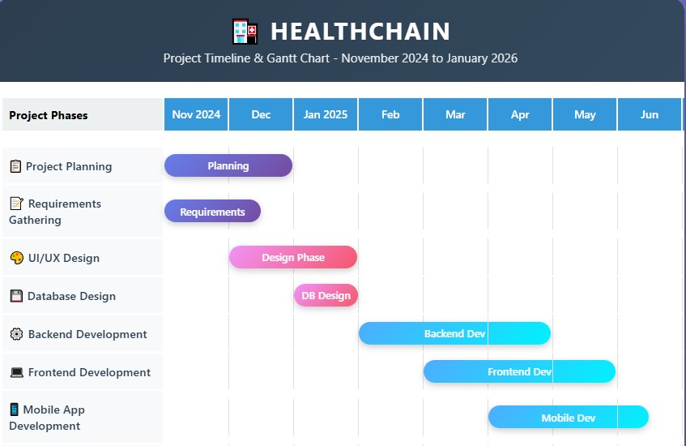
Timeline / Gantt Chart

Slide 8
Challenges
Learning blockchain development.
Integrating payment gateways.
Ensuring data privacy and security.
Coordination with hospitals.

Slide 9

Conclusion & Future Enhancements
ChainHeart improves transparency in charity.
Blockchain ensures trust and accountability.
Future: Mobile app development.
Future: AI-based fraud detection.

Slide 10
THANK YOU

